Slide 1
SSW-810: Software Engineering Tools and Techniques
Container Classes: Lists
Dr. Raz Sarmi
Software Engineering
School of Systems and Enterprises
This Lecture is based on material from Prof. Jim Rowland

Slide 2
Acknowledgements
This lecture includes material from
“How to Think Like a Computer Scientist: Learning with Python 3 (RLE)”, Peter Wentworth, Jeffrey Elkner, Allen B. Downey, and Chris Meyers,
http://openbookproject.net/thinkcs/python/english3e/
And
“Introducing Python”, Bill Lubanovic, ISBN-13: 978-1449359362
http://proquest.safaribooksonline.com/book/programming/python/9781449361167
https://docs.python.org/3/library/stdtypes.html

Slide 3

Today’s topics
Container Classes
Lists, tuples, dictionaries, sets
Lists
Creating lists
List methods
When things go wrong
List comprehensions
Improving algorithm performance
Speed/Space tradeoff

Slide 4
Containers
Python provides several different types of containers
Lists - arbitrary values and mutable - [1, 2, 3]
Tuples - like a list, but immutable - (1, 2, 3)
Dictionaries – Key/Value pairs – {’one’:1, ‘two’:2, ‘three’:3}
Sets – {1, 2 3}
Like lists, but with only unique values
Like lists, but unordered
Like dictionaries with keys but no values
These containers are fundamental in Python and are used in most Python programs

Slide 5
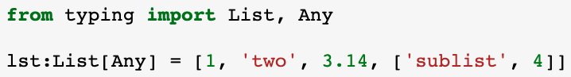
Lists
Lists are an ordered collection of values of potentially different types, including numbers, strings, lists, tuples, sets, …
Lists are surrounded by square brackets [ ]
The values can be any Python object, e.g. int, float,str, list, dict, instance of class, …
Any matches any type

Slide 6
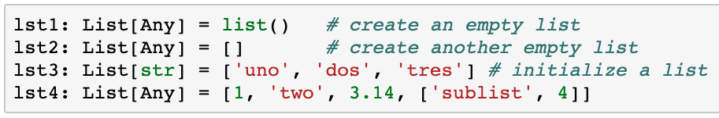
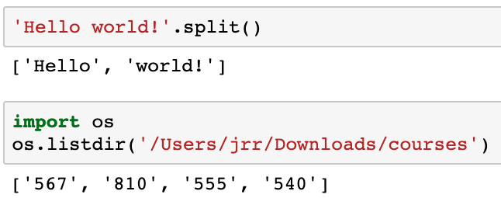
Create a list
Some functions return lists

Slide 7
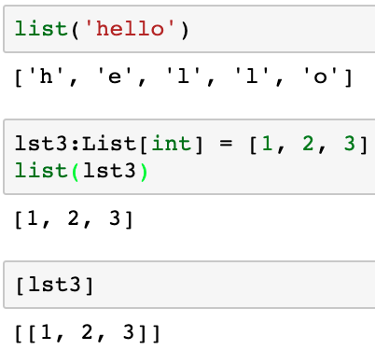
Creating a list from a sequence
Careful! Not [‘hello’]
list() takes an optional argument which must be a sequence, e.g. string, range, list, dict, or set.
The new list contains the elements in the sequence, not the sequence itself
Create a list with the 3 elements in lst3
Create a list with 1 element, lst3

Slide 8
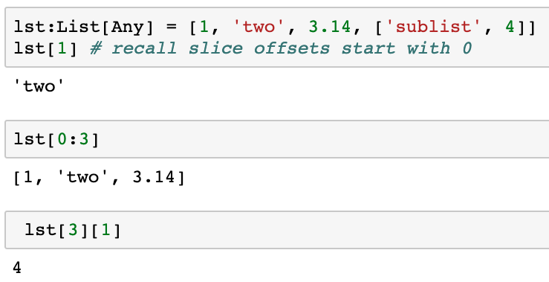
Accessing list elements with index and slices
Index and slices work the same with lists as with strings

Slide 9
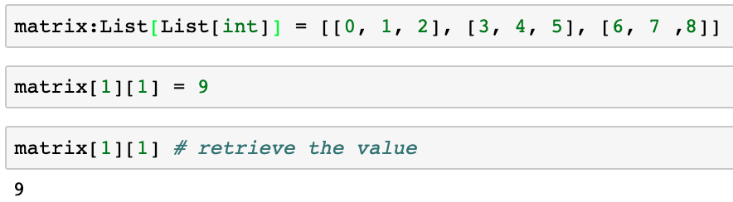
Lists of Lists
How can we use lists to store multidimensional arrays?
How can I store the following matrix in Python?
0 | 1 | 2
3 | 4 | 5
6 | 7 | 8

Slide 10
Binary Trees (B-Trees)
A binary tree is a graph where each node has value and 0, 1, or 2 child nodes where all values in the left subtree are less than the value of the node and all values in right subtree are greater than the value of the node.
You can determine if a value is in a binary tree by searching the appropriate half of the tree
if target == node:
found it!
elif target < node:
search the left subtree
else:
search the right subtree
27
13
30
2
14
25

Slide 11
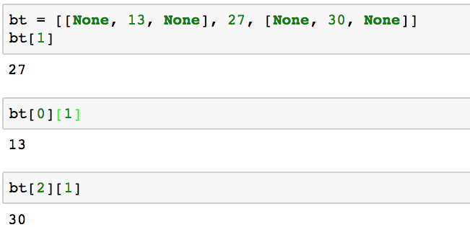
Binary Trees (B-Trees)
Alternatively,
class BTree:
value
left
right
How to represent a B-Tree with lists?
Store Each node is list with three elements:
[left_subtree, value, right_subtree]
27
13
30

Slide 12
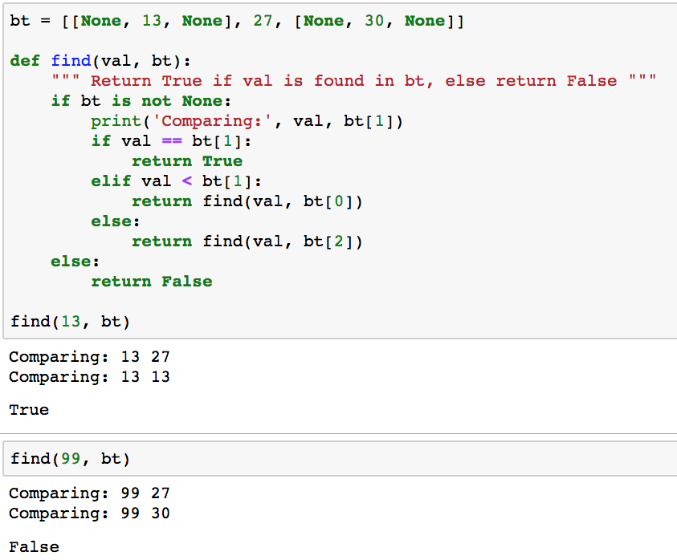
Searching Binary Trees (B-Trees)
27
13
30

Slide 13
Traversing Binary Trees Recursively
Task: traverse the nodes from small to large
Solution:
Traverse(root/top of the tree)
Traverse(node):
If a terminal node (no children):
Consume/display the value
return
If node has a left child:
Traverse(left child)
Consume/display the value
If node has a right child:
Traverse(right child)
Return
27
13
30
2
14
25
The run time stack keeps track of where you are and where to return

Slide 14
Inserting into Binary Trees (B-Trees)
Task: insert a new value in the tree
Solution:
Start at the root of the tree
Compare the new value to the value of the current node
If the new value == current value then done
If the new value < current value traverse the left side of the current node
If the new value > current value traverse the right side of the current node
Once you reach a terminal node, insert the new node
Start
27
13
30
Insert 14
1
27
2
13
30
3
14

Slide 15
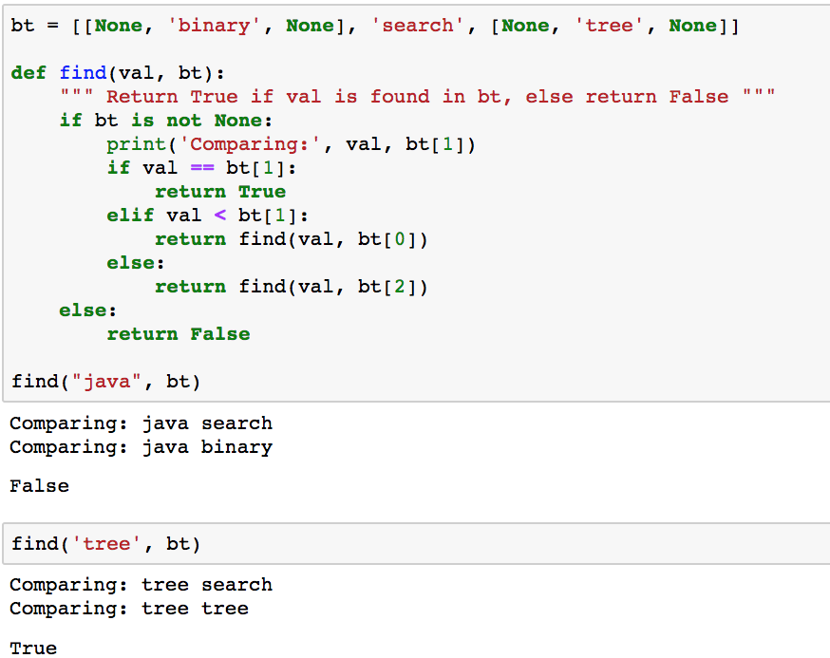
Searching Binary Trees (B-Trees)
The same code works with different data types
search
binary
tree

Slide 16
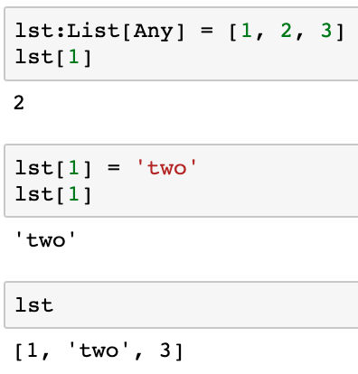
Modify lists with an index
Lists are mutable, i.e. they can be changed

Slide 17
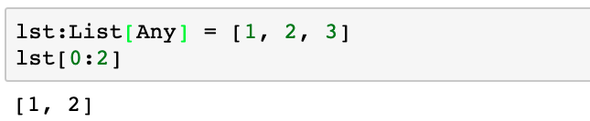
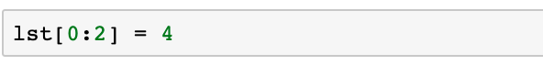
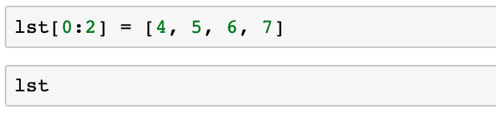
Modify list slice with an iterable
A list slice may be modified with an iterable
Change elements from 0 to 1
The replacement may be a different size, but it must be an iterable

Slide 18
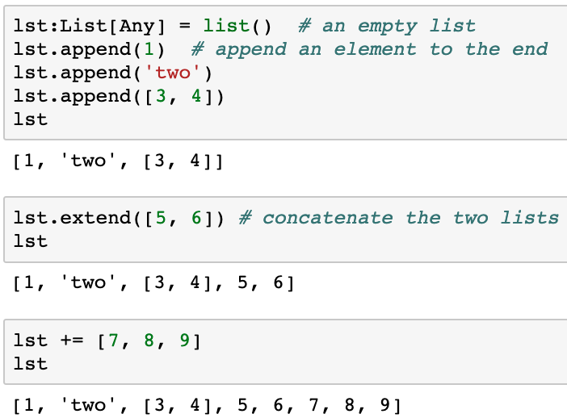
Lists are mutable: add items
list.append(), list.extend(), +=

Slide 19
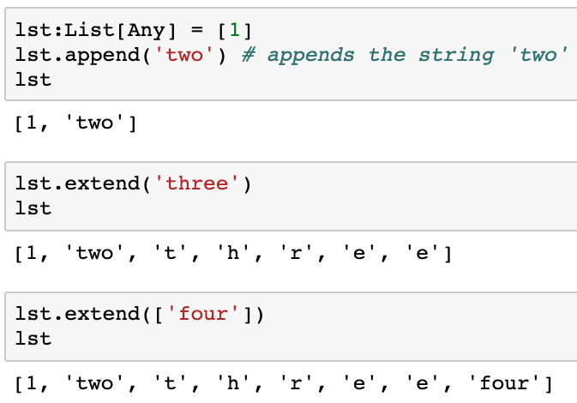
Careful with appending strings to lists
list.extend() and += may surprise you
Recall that a string is a sequence with an iterator
list.extend(item) expects item to have an iterator which is applied. Strings have iterators so each character in the string is added .
list1 += list2 is equivalent to
list1.extend(list2)

Slide 20
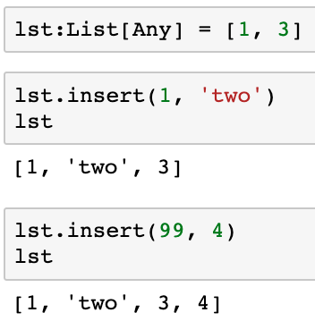
list.insert(index, object)
list.insert(index, object) inserts object at a specific offset in the list
list.insert(index,object) appends the object if index >= len(List)

Slide 21
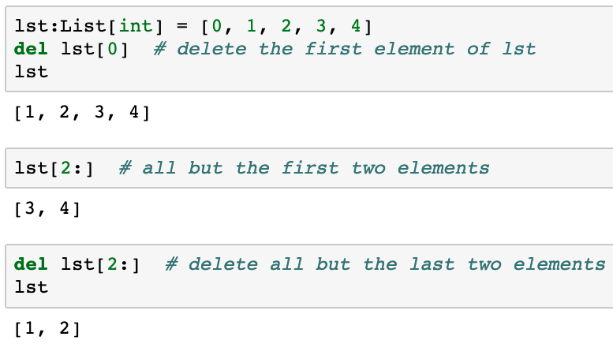
Deleting items from a list
Delete an item(s) from a list with del list[slice]
Note: this is the Python del() function, NOT list.del()
del(), like len(), works on any Python sequence

Slide 22
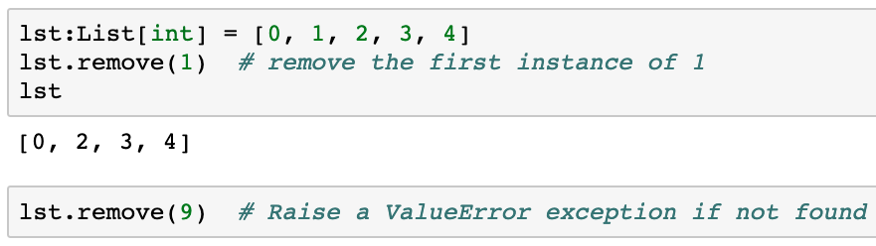
list.remove(value)
Remove an item with a specific value from a list
Only the first instance is removed
Remove the first instance of 1
ValueError exception if not found

Slide 23
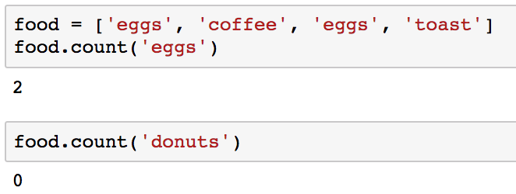
list.count(value)
Count the number of occurrences of value in a list

Slide 24
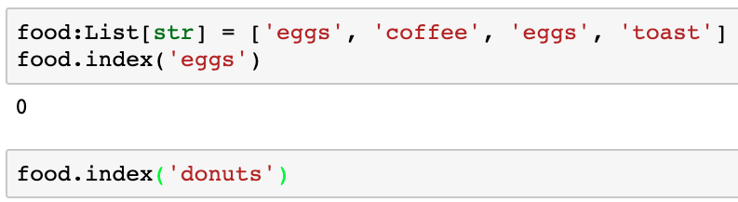
list.index(value)
Return the index of the first occurrence of value in list
Raise ValueError if the value is not found

Slide 25
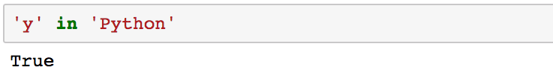
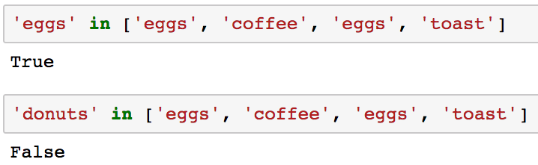
Value in list/Value not in list
Recall that we could say
‘in’ also works with values in a list

Slide 26
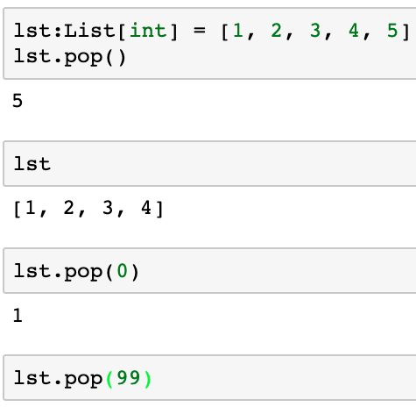
list.pop(index)
Remove and return an item from a list at a specific index
list.pop(index) removes and returns the value at index
list.pop()removes and returns the last value in the list
del and remove remove the item, but don’t return the value
lst.pop(n) where n > len(lst) raises IndexError

Slide 27
Stacks and Queues
Stacks and queues are very common data structures
Source: http://alpcentauri.info/cpp_manual_stacks.htm
Last In First Out
First In First Out

Slide 28
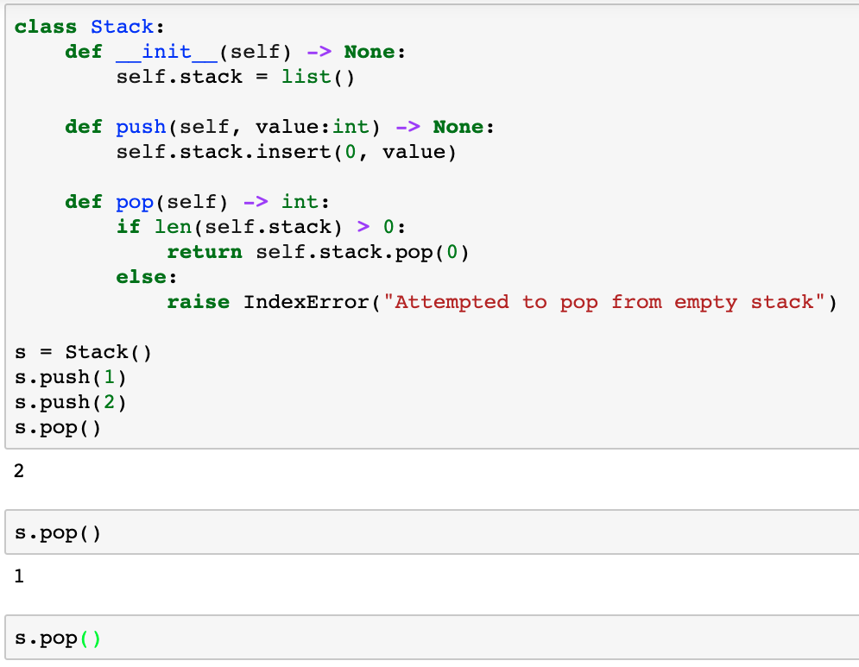
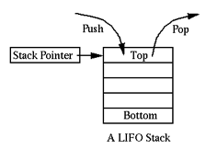
Implement Stacks with a list
LIFO: Last In First Out
LIFO: Last In First Out

Slide 29
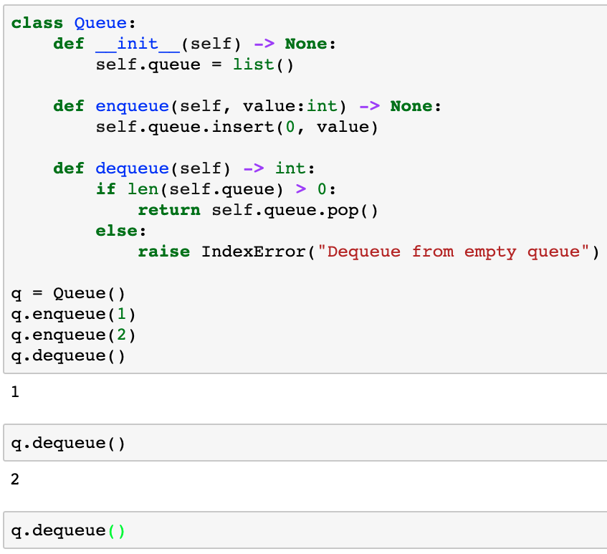
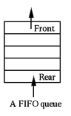
Implement Queues with a list
FIFO: First In First Out
FIFO: First In First Out

Slide 30
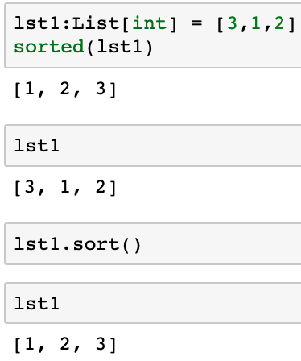
Sorting lists
Two approaches to sort a list
sorted(list) – returns a sorted copy of the list
list.sort() - changes the list in place
Python’s sorted() function, not a method of class list
sorted(lst1) sorts a copy of lst1 so lst1 is unchanged
list.sort() is a statement, not an expression
lst1 is changed because lst1.sort() sorts in place

Slide 31
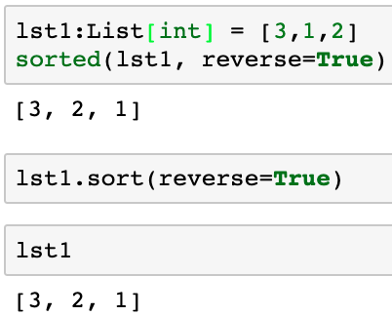
Sorting lists: descending
What if we want to sort a list in descending order?
Two approaches to sort a list
sorted(list, reverse=True) – returns a sorted copy of the list sorted from largest to smallest
list.sort(reverse=True) - changes the list in place
lst1 was changed in place

Slide 32
List methods
Method | Action
list.append(element) | Append an element to a list
list.extend(sequence) | Concatenate list and sequence
list.insert(index, object) | Insert object at position index or at the end if index > len(list)
list.remove(value) | Remove the first instance of list with specified valur or raise ValueError
list.count(value) | Count the number of instances of value in the list
list.index(value) | Return the index of value in list or raise ValueError if not found
list.pop(index) | Remove and return the value at index.
list.pop() | Remove and return the last value in the list
List.sort() | Destructively sort the elements in the list
sorted(list) | Sort a copy of the list
element in list | True if element is a member of list, else False

Slide 33
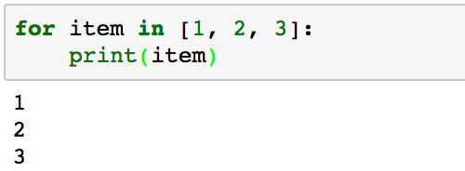
Iterating through list elements
for loop iterates through list elements

Slide 34
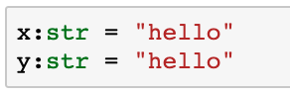
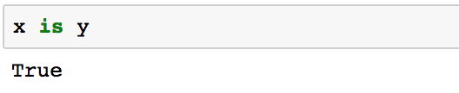
Objects and references
Strings are immutable so Python saves space by storing the string once and x and y reference the same object in memory
Python’s is operator returns True if the same object
x
“Hello”
y

Slide 35
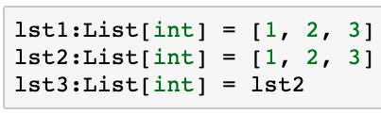
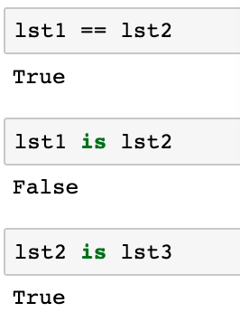
Objects and references
lst1
[1, 2, 3]
lst2
[1, 2, 3]
lst3
Lists are mutable so each list is stored separately
lst1 and lst2 have the same values so __eq__
lst1 and lst2 are different instances of class list
lst2 and lst3 are the same instance of class list

Slide 36
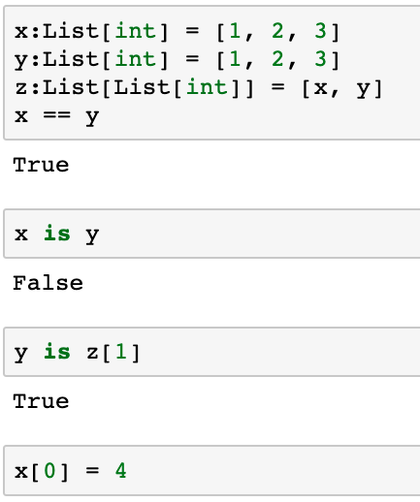
Objects and references
y
x
[1, 2, 3]
[1, 2, 3]
,
z
What happens to z?

Slide 37
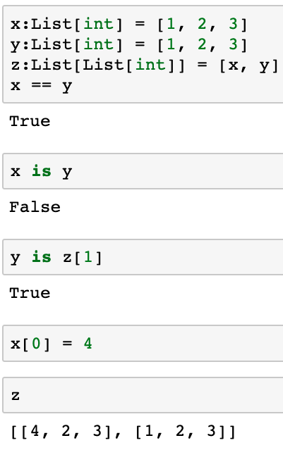
Objects and references
y
x
[4, 2, 3]
[1, 2, 3]
,
z
What happens to z?

Slide 38
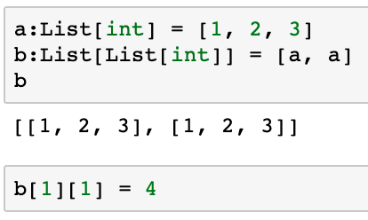
Objects and references
a
[1, 2, 3]
[1, 2, 3]
,
b
What happens to b?
What happens to a?

Slide 39
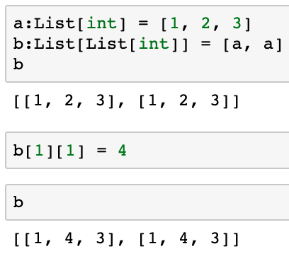
Objects and references
a
[1, 4, 3]
[1, 4, 3]
,
b
Just be aware so you’re not surprised

Slide 40
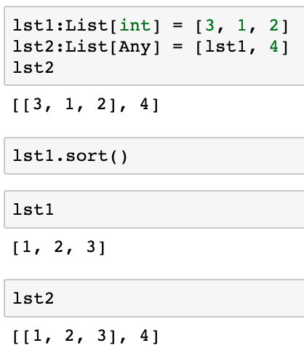
Careful with sorting in place
lst1
[3, 1, 2]
4
,
lst2
Choose list.sort() and sorted(list) carefully!
Both are appropriate in different circumstances
lst1 was changed in place
lst2 was also changed

Slide 41
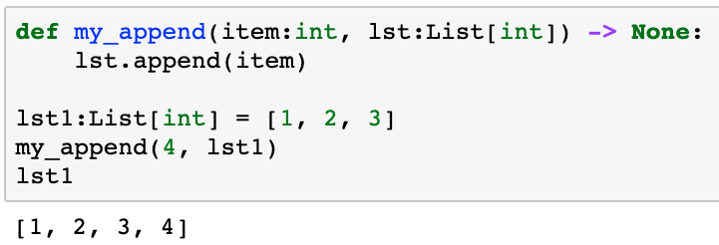
Passing lists as function arguments
Python passes arguments by assignment
As a ”pointer” to the object rather than a copy
Lists passed to functions as parameters may be changed by the function as a side effect
Just be aware so you’re not surprised
Keep this in mind when debugging!

Slide 42
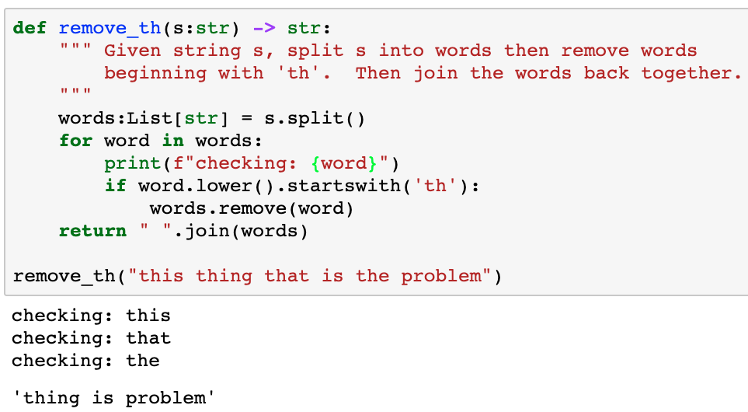
CAUTION!!! Never iterate over a changing a list
Iterating over a copy works properly
Iterating over a changing list is dangerous
checking ‘this’: OK
skipped checking ’thing’
skipped checking ‘is’
skipped checking ‘problem’

Slide 43
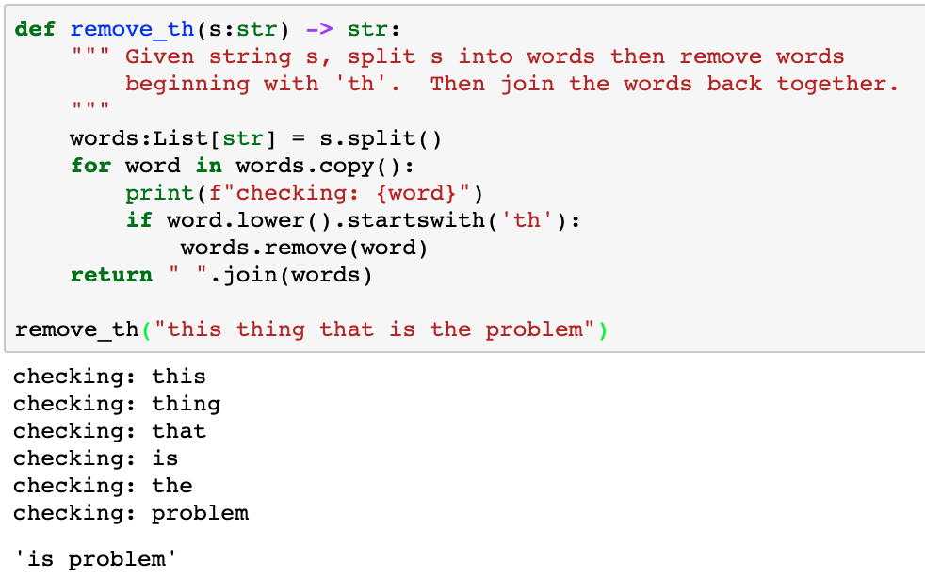
CAUTION!!! Never iterate over a changing a list
Iterate over a copy of the list for the expected behavior
Modify the original list
Here’s the words to check
That’s better!

Slide 44
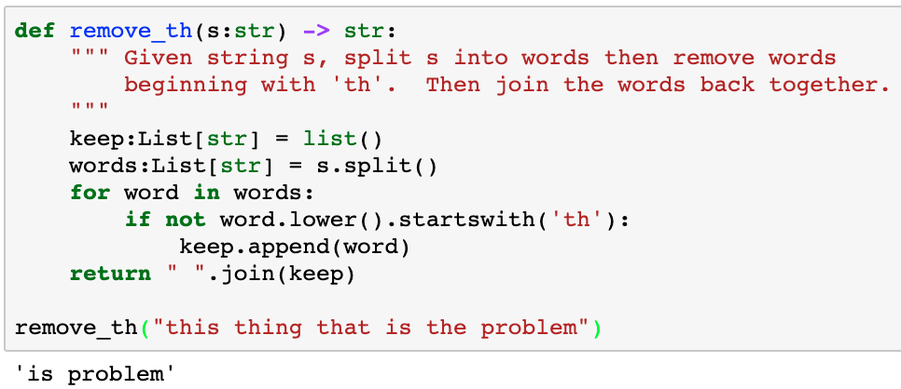
A more ”Pythonic” solution
A list of words to keep
Add this word to keep
That’s better!
We’ll see how to use a list comprehension to simplify the function

Slide 45
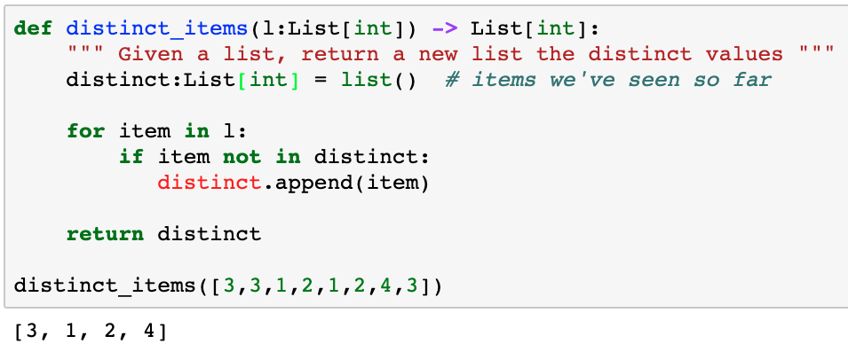
Using lists
Write a function that given a list, returns a list of distinct values
Use the same approach as remove_th()
This is a common pattern in Python programs
The values we want to keep
Keep this value

Slide 46
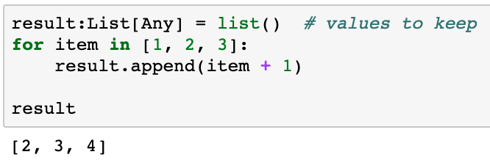
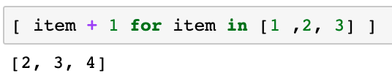
List comprehensions
Transforming lists is very common in Python programs
List comprehensions are a syntactic shortcut
Same logic with list comprehensions (1 line vs. 3 lines)

Slide 47
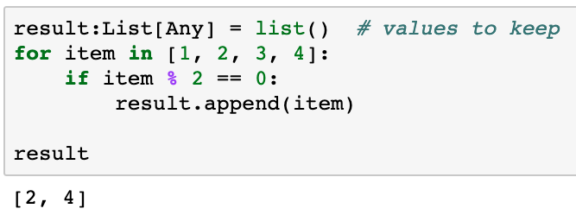
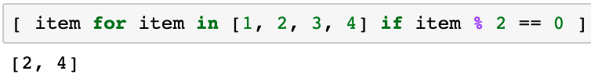
Conditional list filtering
Same logic with list comprehensions (1 line vs. 4 lines)

Slide 48
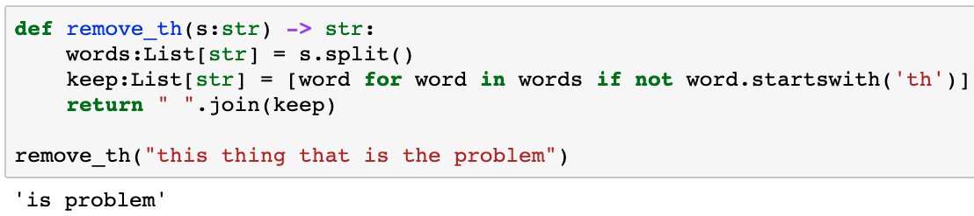
remove_th() with list comprehensions

Slide 49
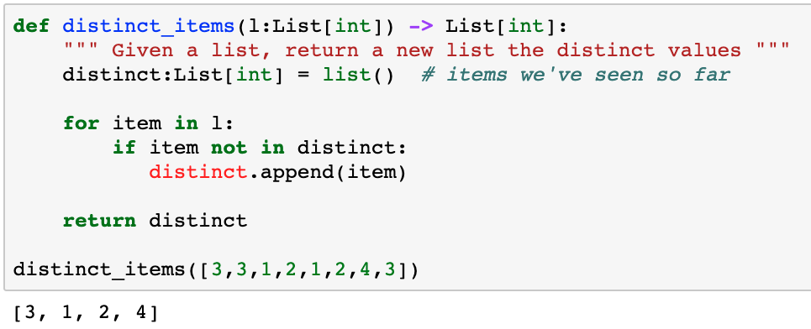
distinct_values()with list comprehensions?
List comprehensions don’t help in this context because we need to access the intermediate list of distinct values

Slide 50

Nested list comprehensions

Slide 51
Debugging list comprehensions
Debugging list comprehensions can be challenging
Try reading the code
Expand the code and debug
Rewrite as a list comprehension

Slide 52


Slide 53
Optimizing algorithms
Sometimes, a little extra thought can dramatically improve the performance of our algorithms
Sometimes, storing extra information can help…
Write a generator to compute all prime numbers
How would you do it?

Slide 54

Naïve prime number generator
How many times do we execute this statement?
for/else simplifies code in some situations

Slide 55
Prime number generation
Task: Write a generator to compute all prime numbers
How many modulo calculations? How long?
Can we reduce the number of modulo calculations?
N | Mod Calculations | Time (seconds)
100 | 1233 | 0.08
200 | 4426 | 0.39
400 | 14,845 | 1.66
800 | 51,488 | 7.50

Slide 56
Better prime number generation
Can we reduce the number of modulo calculations?
Yes! Divide only by prime numbers <= n
But then we need to store all prime numbers <= n
Speed/Space trade off

Slide 57

Better prime number generation
Change generator to store all primes as they are calculated!

Slide 58
Better prime number generation
How many comparisons? How long?
A small change to the algorithm makes
a big performance improvement!
N | Naïve Mod Calculations | Improved Mod Calculations | Naïve Time (seconds) | Improved Time (seconds)
100 | 1233 | 438 | 0.08 | 0.04
200 | 4426 | 1283 | 0.39 | 0.08
400 | 14,845 | 3642 | 1.66 | 0.28
800 | 51,488 | 10,830 | 7.50 | 1.03

Slide 60
Optional Homework 06: reorder
Python provides efficient sort utilities for all sequences
Useful to understand a few simple sorting algorithms
Insertion sort is probably the simplest to implement
Simply insert elements into a new list in the proper spot
reorder(5, 1, 3, 2)
You MUST use this approach for HW06, not Google!
Result before insertion | New item to insert | Result after insertion
[ ] | 5 | [5]
[5] | 1 | [1, 5]
[1, 5] | 3 | [1, 3, 5]
[1, 3, 5] | 2 | [1, 2, 3, 5]

Slide 61

Questions?

